Slide 1
Lecture 4 Basics of Research II
Dr.Uma Mohan

Slide 2

RESEARCH STRATEGIES
A Research Strategy is a step-by-step plan of action that gives direction to your thoughts and efforts, enabling you to conduct research ( operationalize) in a systematic way and on schedule to produce quality results and detailed reporting.
A research strategy is often impacted by the time and resources available for the research , particularly in Business Research and ethical considerations that need to be addressed.

Slide 3
RESEARCH STRATEGIES
EXPERIMENT *
SURVEY
CASE STUDY
ACTION RESEARCH*
GROUNDED THEORY*
ETHNOGRAPHY*
ARCHIVAL RESEARCH

Slide 4

EXPERIMENT
Used to study causal links
Whether a change in one independent variable produces a change in another dependent variable. Hakim (2000)
Tends to be used in exploratory and explanatory research to answer ‘how’ and ‘why’.

Slide 5

CASE STUDY
Involves empirical investigation of a particular contemporary phenomenon within its real life context using multiple sources. Robson (2002:178)
Has considerable ability to generate answers to the question ‘why’ as well as ‘what’ and ‘how’
May require the triangulation of multiple sources of data

Slide 6

SURVEY
Usually associated with the deductive approach
Popular and common strategy used in Business and Management research
Most frequently used to answer ‘who’, ‘what’, ‘where’, ‘how much’ and ‘how many’ questions.
Allows you to collect quantitative data which you can analyse using descriptive and inferential statistics
Comprises a cross-sectional design to which data are collected predominately by questionnaire or by structured interview on more than one case at a single time

Slide 7
Example of Survey
Favourite Chocolate Bar Survey
1) Which age range are you?
15 -20
21-30
30+
2) How often do you eat chocolate?
1-3 times a week
More than 5 times a week
Every day
I never eat chocolate
3) Which brand of chocolate is your favourite?
Cadbury
Nestle
Other

Slide 8
ACTION RESEARCH
Focuses upon and emphasises the purpose of the research: research in action rather than about action (Coglan and Brannick, 2005)
Relates to the environment of practitioners in the research and in particular a collaborative democratic partnership between practitioners and researchers
Emphasises the iterative nature of the process of diagnosing, planning, taking action and evaluating
It should have implications beyond the immediate project

Slide 9

GROUNDED THEORY
Data collection starts without the formation of an initial theoretical framework
Theory generated by a series of observations
Ideal example of the inductive approach

Slide 10

ETHNOGRAPHY
Purpose is to describe and explain the social world the research subjects inhabit in the way in which they would describe and explain it
The research process needs to be flexible and responsive to change as new patterns of thought about what is being observed are constantly being developed by the researcher
Rooted firmly in the inductive approach
Strategy is naturalistic

Slide 11

ARCHIVAL RESEARCH
Makes use of administrative records and documents as the principal source of data
Allows research questions which focus upon the past and changes over time to be answered, be they exploratory or descriptive

Slide 12
At this stage, we need to decide on another aspect- Quantitative versus Qualitative
Quantitative uses a positivism philosophy, deductive approach and numeric data
( survey) , whereas,
Qualitative uses an interpretivism philosophy, an inductive approach and non-numeric (words or text based) data ( interview)
However, Quantitative and Qualitative techniques and Procedures can be mixed or can be used on their own depending on the Research Questions you are trying to answer.

Slide 13
What is the difference ?
Quantitative- Any data collection techniques (questionnaire) or data analysis procedure (such as graphs or statistics) that generates or uses numerical data.
Qualitative- Any data collection technique such as (interviews) or data analysis procedure (such as categorising data) that generates or uses non-numeric data, like themes .

Slide 14
Quantitative vs. Qualitative (Contd)
Quantitative research
systematically observe changes in the phenomena of interest while manipulating what are believed to be causal influences ( like impact of X on Y) or links between variables.
Qualitative research
may be more concerned with the individual’s personal experiences of the problem under study

Slide 15
Mono method and Multiple methods
Mono Method
Uses a single data collection technique and corresponding analysis procedure
Multiple Method
Uses more than one data collection technique and analysis procedure
Used widely in Business and Management research
(Useful if they provide you a better opportunity to answer your research question and to the extent to which they allow you to better evaluate that the findings are valid and reliable).

Slide 16
Mixed methods
‘Mixed methods’ is a research approach whereby researchers collect and analyse both quantitative and qualitative data within the same study ( often to address multiple research questions).
For example, use a survey for the junior level employees and interviews for the senior level employees of the same organization to collect rich data on the perspectives about a topic of research interest.

Slide 17
Which Research Method is best?
It depends on the Research question and the researchers skills.
However, It is extremely important to have
a clear research question and objective for your research and
ensure that the methods you use will enable you to answer your research question and meet your research objectives

Slide 18
TIME HORIZONS
The choice of time horizon depends on the research question
Cross-sectional
Longitudinal

Slide 19
CROSS-SECTIONAL STUDIES
The study of a particular phenomenon (or phenomena) at a particular time
Snapshot view
Often employs survey strategy

Slide 20
LONGITUDINAL
Diary perspective
Observing people and events over time
Researcher is able to exercise a measure of control over variables being studied, provided they are not affected by the research process itself

Slide 21
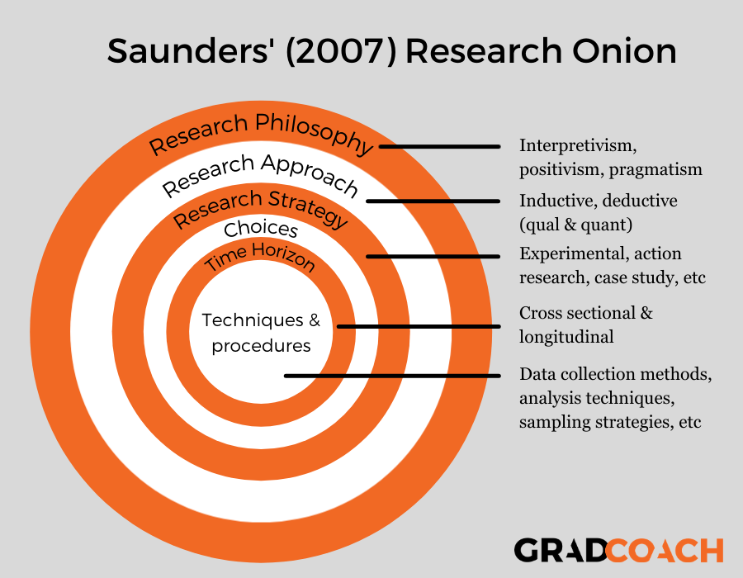
Research onion made simple Melnikovas, A., 2018. Towards an explicit research methodology: Adapting research onion model for futures studies. Journal of Futures Studies, 23(2), pp.29-44.

